Slide 1
COMP1201 Algorithmics
Lecture 0 Introduction
Jie Zhang
jie.zhang@soton.ac.uk
Electronics and Computer Science
University of Southampton

Slide 2
What is this part about?
Graph Theory and Algorithms
Tree, Eulerian graph, Hamiltonian graph, Matching, Planar graphs, Isomorphism, Flows & Cuts, Shortest Path, Minimum Spanning Tree, Network Flow, etc
Dynamic Programming

Slide 3
Logistics
Six lectures (three for each week)
Two tutorials (one for each week)
Assessments
Part of the third coursework 5%
Part of the exam
Q&A
https://secure.ecs.soton.ac.uk/student/wiki/w/COMP1201

Slide 4
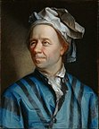
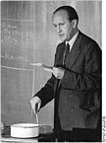


Graph Theory Pioneers
Leonhard Euler
The Father of Graph Theory
Planar graph theory
Calculus
Pál Turán
Extremal graph theory
Number theory
Béla Bollobás
Random graphs (Percolation)
Extremal graph theory
Combinatorics
And many more …

Slide 5
Graph Algorithms Pioneers
Jack Edmonds
Combinatorial Optimization
Matching algorithms
NP and P
Richard M. Karp
Combinatorial algorithms
Operational Research
John Hopcroft
Planar graph algorithms
Matching algorithms
Edmonds–Karp algorithm (Max-flow)
Hopcroft–Karp algorithm (Bipartite max matching)
And many more …

Slide 6
The tip of an iceberg: PageRank
Vertices: web pages (its URL)
Directed Edges: hyperlink from one web page to another
To construct a web digraph, one needs
a spider (Web crawler) to automatically collect URLs
a graph structure to store vertices (URLs) and edges (hyperlinks)

Slide 7
PageRank: Definition
Assume page A has pages T₁...T_{n} which point to it (i.e., back links or citations). Its Page Rank is defined as follows:
Where C(T_{i}) is the number of links going out of page T_{i}
d is a damping factor which can be set between 0 and 1 (usually set d to 0.85)
Idea: voting
Question: can you calculate the PageRank of the web pages in this graph?

Slide 8
PageRank: Computation
Notice that the definition of PR(A) is cyclic.
I.e., ranks of web pages are used to calculate the ranks of web pages
However, Page Ranks can be calculated using an algorithm that corresponds to computing the principal eigenvector of the normalized link matrix of the web.

Slide 9
PageRank: Complexity
The whole digraph (URLs, HYPERLINKs) is huge:
It is reported that a Page Rank for 26 million web pages can be computed in a few hours on a medium size workstation.
Billions of web sites
Google use thousands of workstations.
Dynamic feature (Netcraft):
600k millions active sites
Hundreds new websites are created every minute
Partial map may be enough for some purposes
e.g., we are often interested in a small portion of the whole Internet
Computational complexity, polynomial-time approximation scheme, online algorithms, competitive analysis (worst-, average-, best-case, smoothed analysis), etc.

Slide 10
Social Network as Graphs
“Word-of-mouth” effects
How to find the “target individuals” to market a new product?
David Kempe, Jon Kleinberg, Éva Tardos, Maximizing the spread of influence through a social network, KDD 2003.
David Kempe, Jon Kleinberg, Éva Tardos, Influential nodes in a diffusion model for social networks, ICALP 2005.
Primal: Given limited advert time/energy/resources, maximize the number of people who will buy the new product.
Dual: Given that the objective is to influence xx% crowd, how to minimize the amount of advert resources

Slide 11
Optional Books and Online Courses
J.A. Bondy and U.S.R. Murty, Graph Theory with Applications.
1st Edition 1976; 2nd Edition 2008.
Shimon Even, Graph Algorithms.
1st Edition 1979; 2nd Edition 2011.
David Easley and Jon Kleinberg, Networks, Crowds, and Markets. 2010.
Richard Bellman, Dynamic Programming, 2003.
Stanford Openclassroom, Design and Analysis of Algorithms, Chapters 5 -- 9
MIT Open Course, Mathematics for Computer Science, Lectures 6 -- 10

Slide 12
Intended Learning Outcomes
Formation of any science: desired to solve a specific problem, triggered the incentive to establish a novel system of techniques in solving similar problems.
Construct/design/develop new methodologies and better solutions
Evaluate/apply methodologies
Interpret/analyze/solve exercises
Understand/describe/explain algorithms
Remember/memorize concepts

Slide 13
COMP1201
Algorithms
Lecture 1 Graph Theory
Jie Zhang
jie.zhang@soton.ac.uk
Electronics and Computer Science
University of Southampton

Slide 14
Standard Terminologies
Graph G = (V, E), where V={v₁,…,v_{i} , …v_{n}} is the set of vertices/nodes and E={e₁,…, e_{k} , …, e_{m}} is the set of edges.
|V| = n, the number of vertices; |E| = m, the number of edges;
Edge e_{k}= v_{i}v_{j} : vertices v_{i} and v_{j} are connected by edge e_{k}
d(v_{i}): Degree of a vertex – the number of edges adjacent to vertex v_{i}
Walk: a sequence of alternating vertices and edges of a graph (vertex can be repeated; edge can be repeated)
Trail: if the edges of a walk are distinct, then the walk is a trail
Path: if, in addition, the vertices of the trail are distinct, then it is called a path.
Walk | can repeat
vertex | √
edge | √
Trail | can repeat
vertex | √
edge | ×
Path | can repeat
vertex | ×
edge | ×

Slide 15
Standard Terminologies (cont)
Circuit: a closed trail.
Cycle: a closed path.
Connected graph: a graph in which there is a route from each vertex to any other vertex.
Tree: a connected graph with no cycles. Its degree-1 vertices are called leaves.
Forest: every connected component is a tree. Alternatively speaking, a graph with no cycles but not necessarily connected.

Slide 16
Standard Terminologies (cont)
Bipartite graph: the vertices can be partitioned into two classes such that every edge has its ends in a different class.
Complete graph: a simple graph in which every pair of vertices is connected by an edge, noted as K_{n} (Q: m = ?)
k-regular graph: every vertex of the graph has the same degree k
Planar graph: a graph that can be drawn with no edges crossing.
Directed graph: a graph in which the edges have directions.
Weighted graph: a graph in which the edges have weights.
Simple graph: finite, unweighted, undirected, no loops, no multiple edges.

Slide 17
Vertex Degree
∑_{i} d(v_{i}) = 2 |E|
i.e., the sum of the degrees of the vertices is always twice the number of edges. -- Why?
⇒ The number of odd-degree vertices in a graph is always even.
⇒ When k is odd, every k-regular graph must have an even number of vertices
An elementary lemma. Useful in advanced topics, e.g., given a Hamiltonian cycle in a cubic graph, there must exists a second Hamiltonian cycle.
How to find a second cycle?
Handshaking Lemma:

Slide 18

Trees
The following statements are equivalent:
T is a tree (Def: no cycles, connected)
Any two vertices of T are linked by a unique path
T is minimally connected, i.e., T is connected but
T - e is disconnected for every edge e ∈ T
T is maximally acyclic, i.e., T contains no cycle but
T + v_{i}v_{j} does, for any two non-adjacent vertices v_{i}, v_{j} ∈ T
T has n-1 edges
Proof:

Slide 19
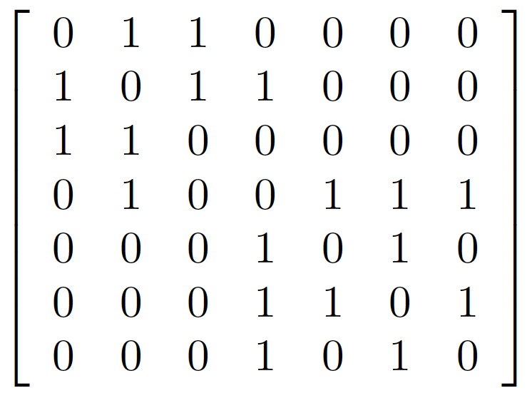
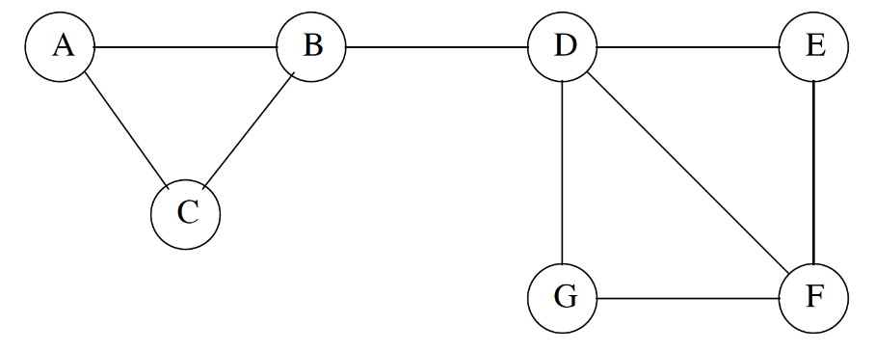
Graph Representation: Adjacency Matrix
Adjacency Matrix: A = (a_{ij}), where a_{ij} = 1 if there is an edge between vertices v_{i} and v_{j}; o.w., a_{ij} = 0.
Two observations:
It is a symmetric & square matrix
Row/column sum = ?

Slide 20
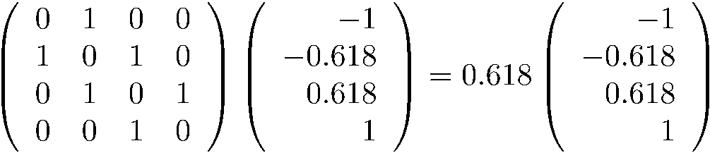
Eigenvalues and Eigenvectors
Graph spectrum: the eigenvalues and eigenvectors of the adjacency matrix
Ax=𝜆x
Example:
An eigenvector x of a linear transformation A is a nonzero vector that, when A is applied to it, does not change direction. Applying A to the eigenvector x only scales the eigenvector by the scalar value λ, called an eigenvalue.

Slide 21
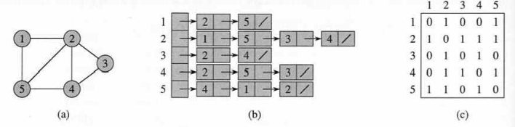
Graph Representation: Adjacency List
An adjacency list representation for a graph associates each vertex in the graph with the collection of its neighboring vertices or edges.

Slide 22
Graph traversal
The process of visiting each vertex in a graph
Breadth First Search (BFS)
Start at a vertex, explores all of its neighbor nodes at the present depth prior to moving on to the nodes at the next depth level.
1, 2, 5, 3, 4
Depth First Search (DFS)
Traverses the depth of any particular path before exploring its breadth
1, 2, 5, 4, 3

Slide 23
Path-searching and Reachability

Slide 24
Walk enumeration
Def: A walk of length k in a graph is a sequence of vertices v₁,…,v_{i},…,v_{k+1} such that v_{i} and v_{i+1} are connected by an edge, ∀ i = 1,…, k. We call a walk closed if v_{k+1} = v₁.
Question: counting the number of length-k walks from v_{i} to v_{j}
In many applications the problem is reduced to walk enumeration.

Slide 25
Walk enumeration
Thm: Let A be the adjacency matrix of the graph G. The number of length-k walks from v_{i} to v_{j} is equal to the i-th row j-th column entry of A^{k}, i.e., a_{ij}^{(k)}
We can also use eigenvalues & eigenvectors to count the number of closed walks in a graph.
Thm: The number of length-k closed walks is equal to tr(A^{k}) = ∑_{i} a_{ii}^{(k)}
Where tr(A) is the trace of square matrix A which is equal to the sum of the elements on the main diagonal of A.
E.g., when k = 3, a closed walk is a cycle.

Slide 26
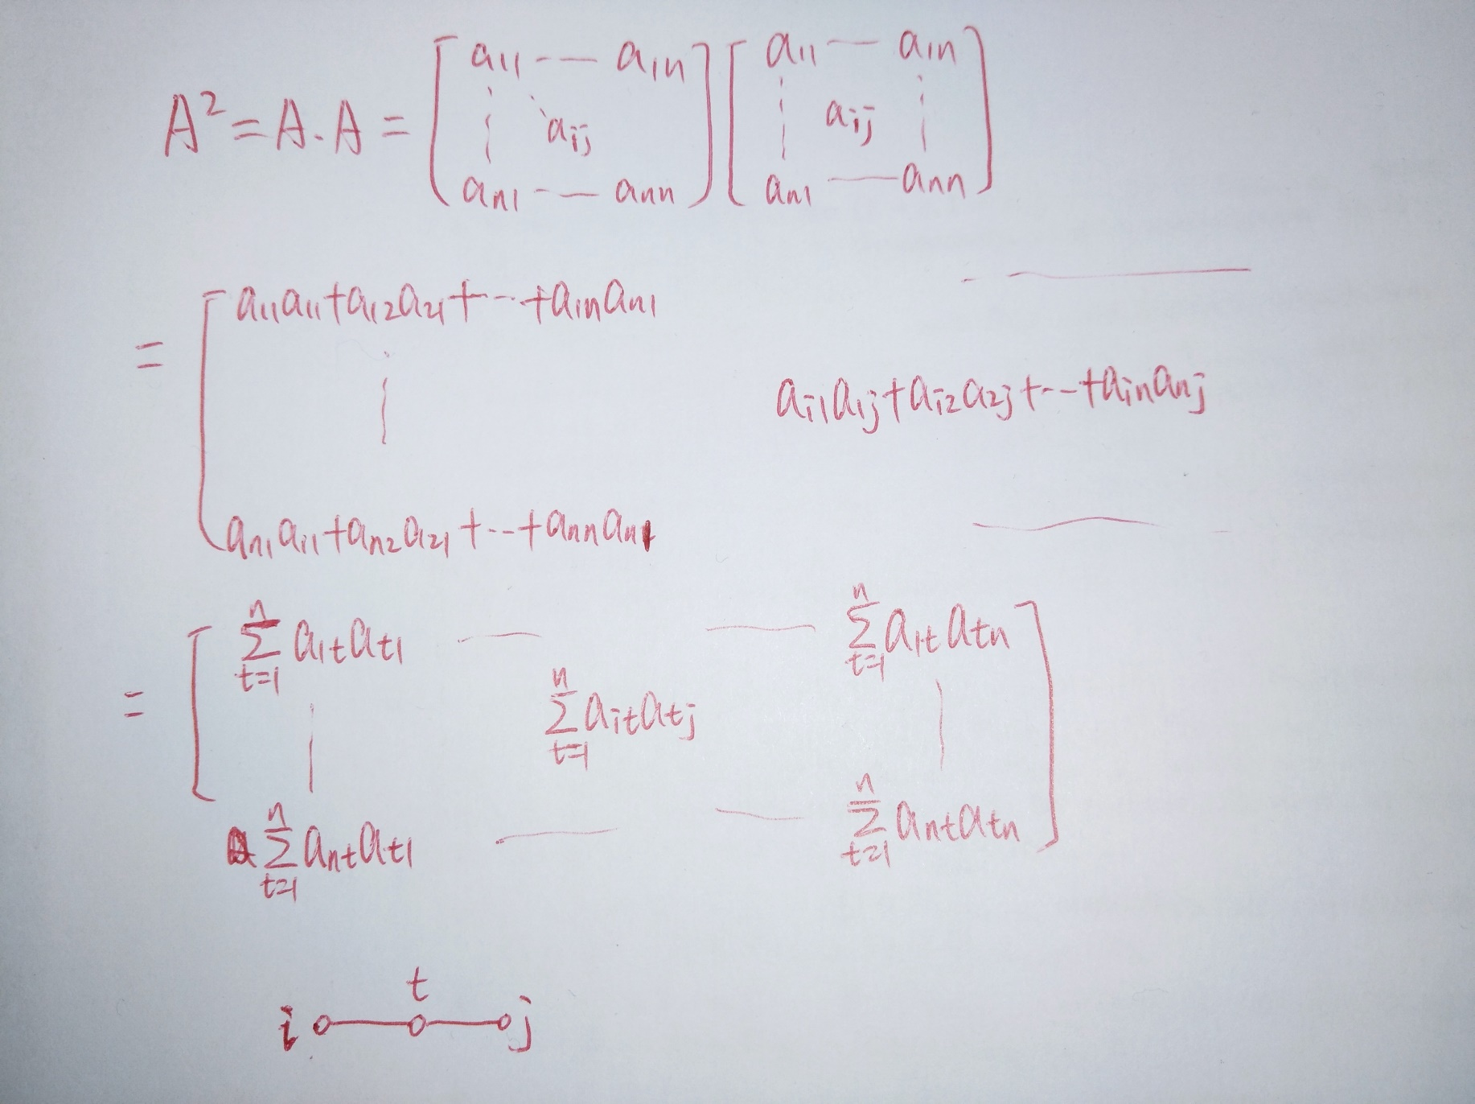

Slide 27
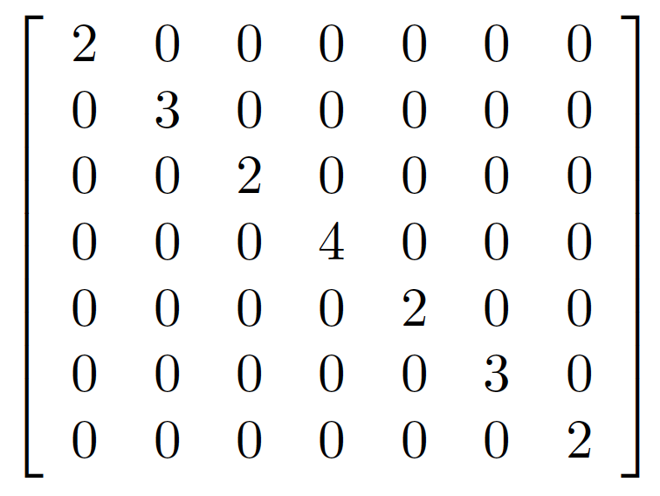

Degree Matrix
Def: D = (a_{ij}), where a_{ii} = d_{i} the degree of vertex v_{i}; a_{ij} = 0 elsewhere.
Not a one-to-one correspondence.

Slide 28
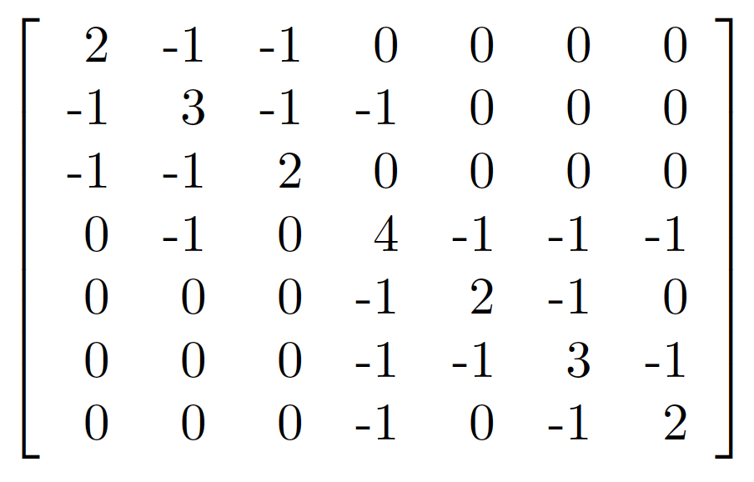
Laplacian Matrix
Def: L = D – A. I.e., the difference between the Degree matrix and the Adjacency matrix.
Each row / each column sums to zero; symmetric.

Slide 29
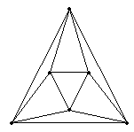
Eulerian graphs
A Euler trail travels every edge exactly once; if it ends at the initial vertex, then it is a Euler circuit.
4-regular
May pass through a vertex multiple
times

Slide 30
Eulerian graphs
Are we able to quickly determine whether or not a Euler cycle exist? I.e., is G a Eulerian graph?
If exist, algorithms to find a Euler cycle?
We observe that in any Eulerian graph, all, or almost all of the vertices, have an even degree. Indeed,
G has no odd-degree vertices = G admits a Euler circuit
“⇐” trivial “⇒” nontrivial
G has only two odd-degree vertices ⇒ G admits a Euler trail
So, deciding whether a graph is Eulerian is easy.

Slide 31
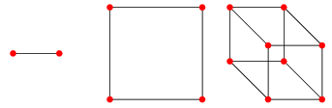
Exercises: Eulerian graphs
Are the following hypercube graphs Eulerian?
Is the Petersen graph Eulerian?
Q₁ 2-path graph
Q₂ square graph
Q₃ cubical graph

Slide 32
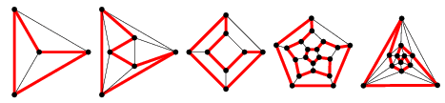
Hamiltonian graphs
A Hamiltonian path is a path that visits every vertex exactly once; if it ends at the initial vertex then it is a Hamiltonian cycle.
May not pass through all edges

Slide 33
Hamiltonian graphs
Hamiltonian graph: a graph that admits a Hamiltonian cycle.
Unfortunately, there is no simple characterization on the existence of a Hamiltonian path/cycle. Moreover, determining whether such paths and cycles exist in a graph is NP-complete.

Slide 34
Exercises: Hamiltonian graphs
Are the following hypercube graphs Hamiltonian?
Is the Petersen graph Hamiltonian?
Q₁ 2-path graph
Q₂ square graph
Q₃ cubical graph

Slide 35
Review & Preview
Basic graph theory concepts
J.A. Bondy and U.S.R. Murty, Graph Theory with Applications.
Chapters 1 to 3
Shimon Even, Graph Algorithms.
Chapters 1 to 3
Euler graph and Hamilton cycles
J.A. Bondy and U.S.R. Murty, Graph Theory with Applications.
Chapter 4
Matching
J.A. Bondy and U.S.R. Murty, Graph Theory with Applications.
Chapter 5
Shimon Even, Graph Algorithms.
Chapter 6

